Slide 1
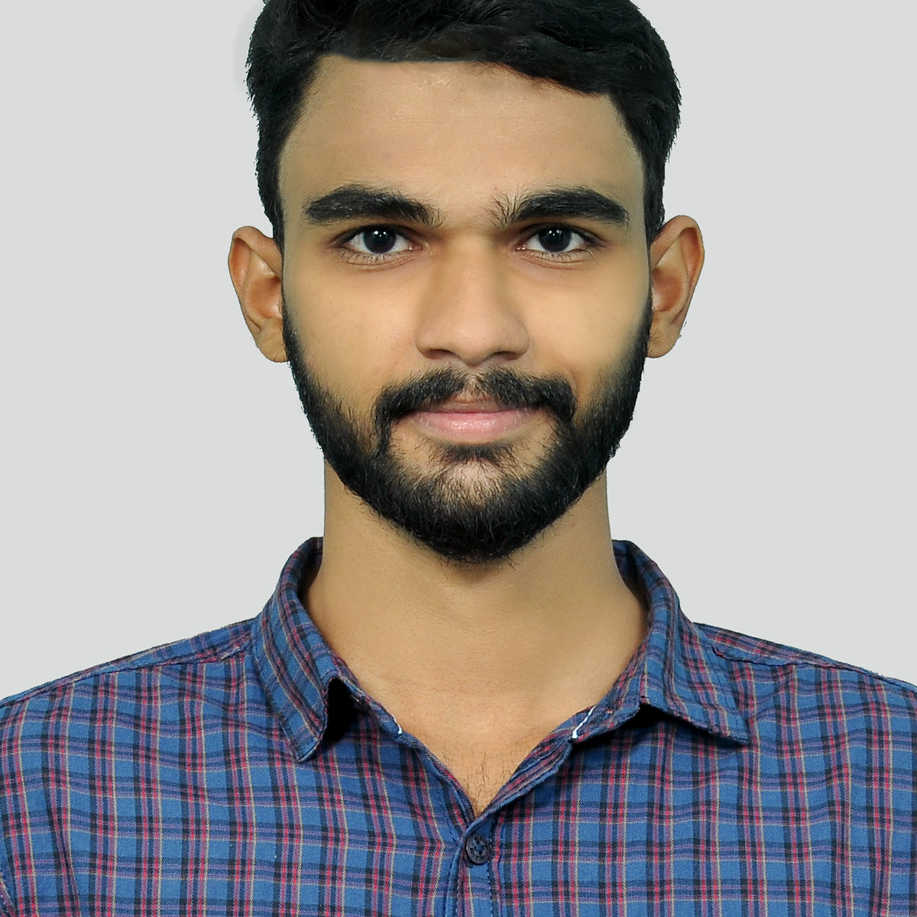



Paramjit Reddy Ergamreddy
Bachelor of Engineering
Computer Science : 2018 - 2022
Analyst
Skills
Java 8 /J2EE | Java Basics, OOPS, Generics, Collections, Arrays, Loops, Lambda Exp, Stream API Junit, Mockito.
Spring core | IOC & Dependency Injection, Autowire
Spring REST | REST controllers, Implementation of GET, POST, PUT & DELETE, & Exception Handling, Testing Services, Controller & Repository layer
Spring Data JPA | Implement spring Data repositories,
Spring Boot Microservices | Spring Boot Starters, annotations, Messaging Service, Sync/Async comms, Swagger API documents
Spring Cloud | Eureka, Server, Spring cloud API Gateway, Hystrix, Netflix Zuul & Config Server
Angular | Components, Services, Modules, Routing, Forms & Validation, Testing using Jasmine & Karma
Database | MongoDB No Sql, My SQL Basics
UI Tech | HTML 5 & CSS 3,JavaScript, ES6 & TypeScript Reusable templates, Angular material,bootstrap
Tools | Git, Postman, Maven, STS,VS code
Add On skills | Self learning
Bangalore
paramjit-reddy.ergamreddy@capgemini.com
+91 6303294914
A4
Full Stack Developer
Hands on experience in creating microservices with Springboot, Spring Security with jwt authentication, Spring Cloud API Gateway, Eureka server.
Proficient in creating Single page Web Application in Angular with Authentication with route guards, Angular reactive forms, angular routing, HTML.
Hands on experience in implementing Mongo DB with spring boot
Experience in creating documentation with swagger and in unit testing using Junit including code quality compliance using Sonar qube.
Development experience in creating docker images and pushing to Docker Hub with containerized applications using Docker SWARM
E-Commerce Shopping Cart Application
Completed end to end case study of Shopping Cart Application along with JWT authentication, Swagger and payment testing using Stripe, responsive UI using CSS and Angular for user interface.Implemeted sonar qube for code quality.
Completed Web Development 2020 course in Internshala
Check out my work on GitHub & Video Profile

